Slide 1
Energy Stock
By Ruiwen Yang, Jiayi Zhou, Yi Zhu

Slide 2
Introduction

Slide 3
Introduction
As the world become more aware of climate change, more people started to interested in investing stocks in green energy for ethical or personal reasons.
Current articles don’t include supportive data about which stocks to invest in→we studied the stock trends
Current articles don’t compare and study the trends of stocks of both green energy companies and fossil fuels companies→we discussed difference in trends of green energy and fossil fuel

Slide 4
Questions

Slide 5
Questions
How does the stock trend of renewable energy and fossil fuel changes and can the future trends be predicted?
How can investors increase their return by investing on stocks in renewable energy and fossil fuel?
Notes:
We want to develop a portfolio for green energy stock for investors who interested in invest in renewable energy and fossil fuel companies.

Slide 6
Data and Methods

Slide 7
Data
Our data is collected from yahoo, with 53 stocks in energy companies--32 in green energy and 21 in fossil fuel.
We did the general cleaning–converting data types in the first section and removing the missing values.
Then we use different approaches to preprocess data.
Clustering–calculated the 5-day return, 20-day return, 60-day return, and 200-day return of each stock and scaled these returns.
Association-based on clustering result, create different datasets, focus on the return feature, re-scaled, and finally encoded when the average of 1-day, 5-day, and 15-day intervals are above 0.
Estimation–performed feature engineering for the Dates and only used the features transformed from dates and close prices.

Slide 8
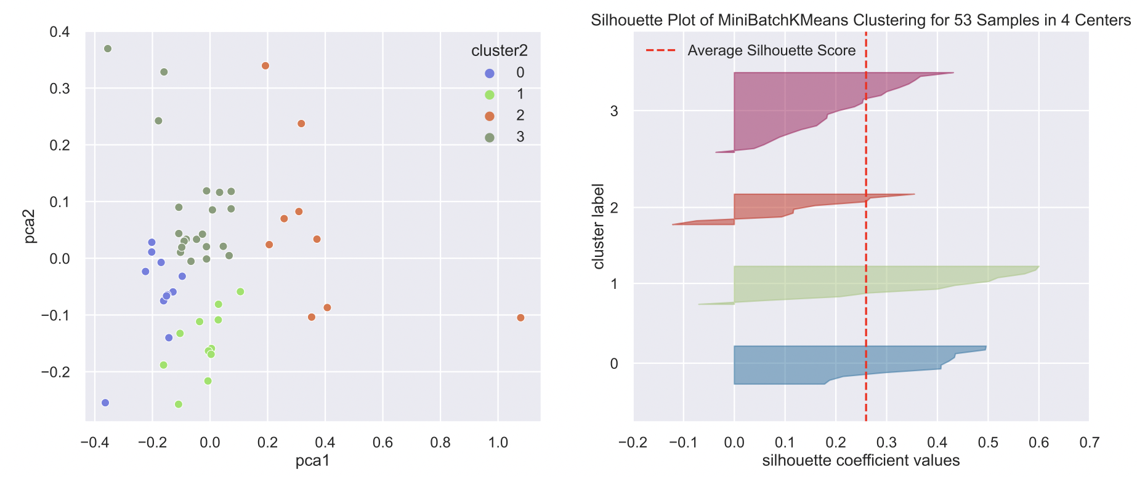
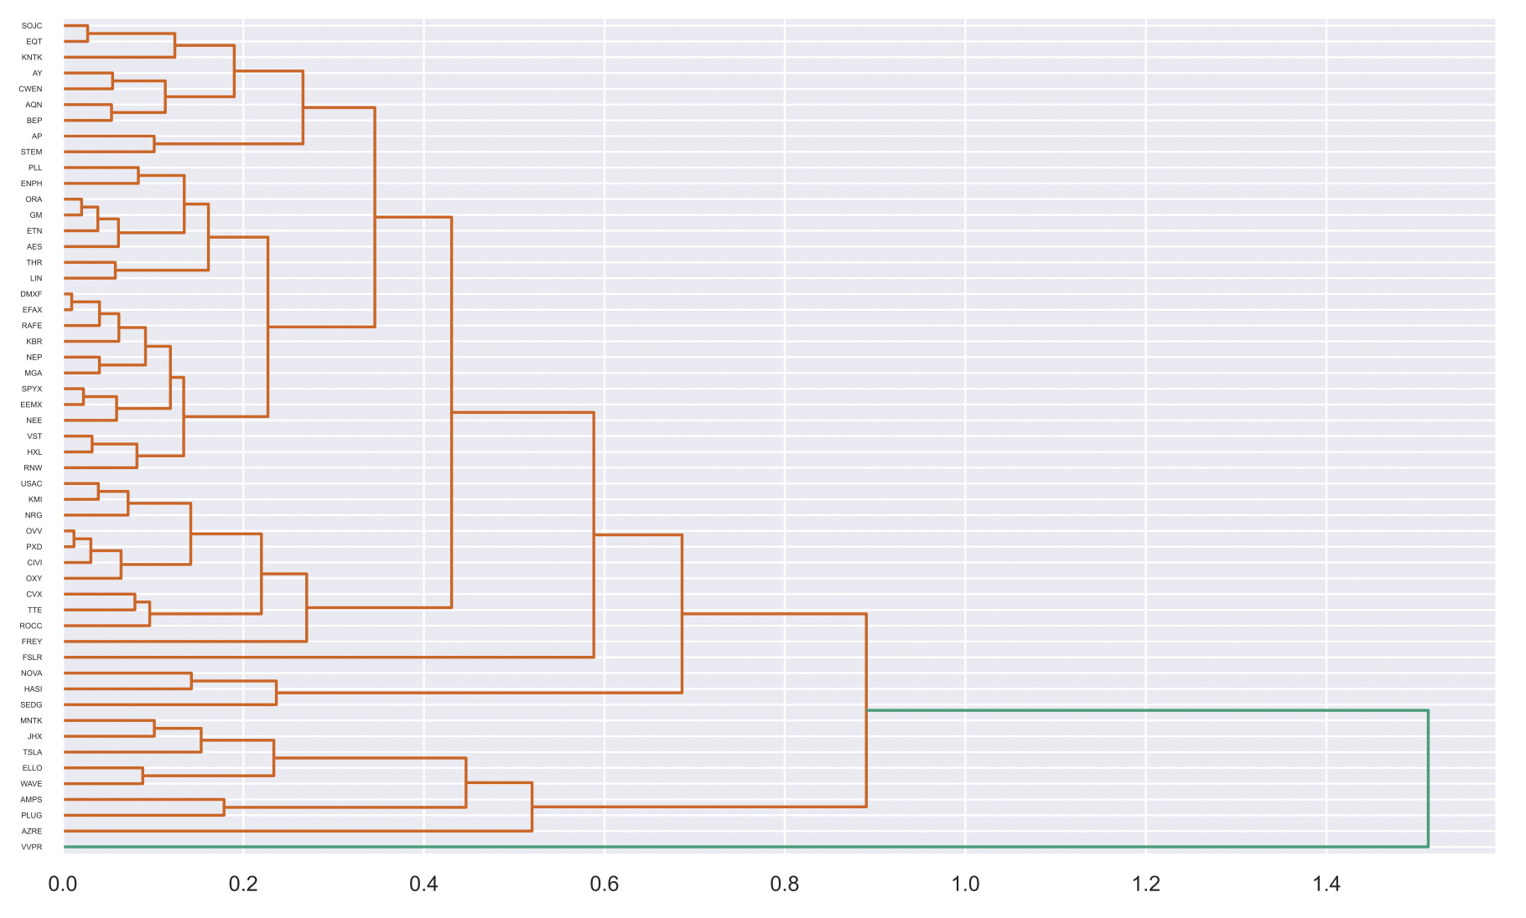
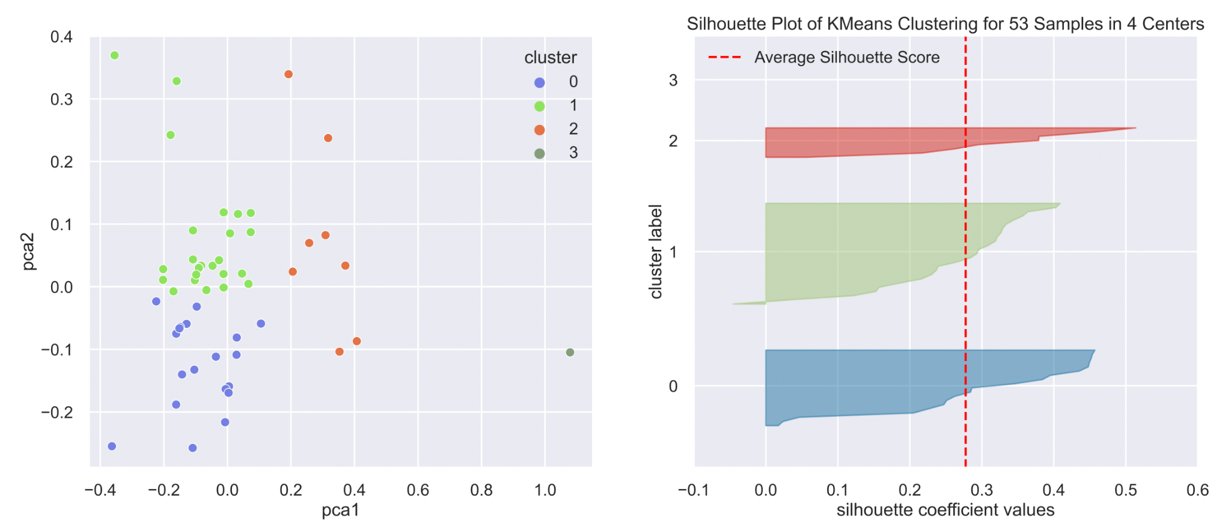
Method–Clustering
Choose KMeans and find the optimal # clusters: 4 using Distortion Score Elbow
After comparing KMeans, MiniBatchKMeans, Hierarchical Clustering.
Use PCA and Silhoutte Values Plot to evaluate.
Notes:
ns such as PCA and Silh

Slide 9
Method–Association Analysis
Based on the clustering result, we performed the association analysis with apriori and fpgrwoth methods to discover more relationships between stocks.
For clusters 0, 1, 2, and 3, we have 19, 25, 8, and 1 stock in the corresponding cluster.
Because cluster 3 only have one stock, we only focus on cluster 0, 1, and 2.
For clusters 0 and 1, we use a confidence level of 0.8.
For cluster 2, we use a confidence level of 0.7.

Slide 10
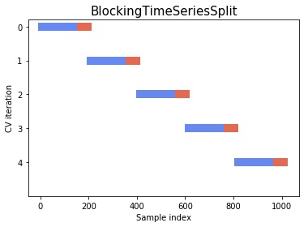
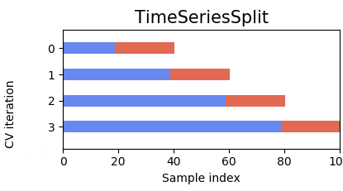
Method–Prediction-estimation
4 estimators: Linear Regression, Support Vector Machine, Decision Tree, Random Forest
2 approaches: Blocked Time Series Split, Normal Time Series Split
Notes:
ns such as PCA and Silh

Slide 11
Results

Slide 12
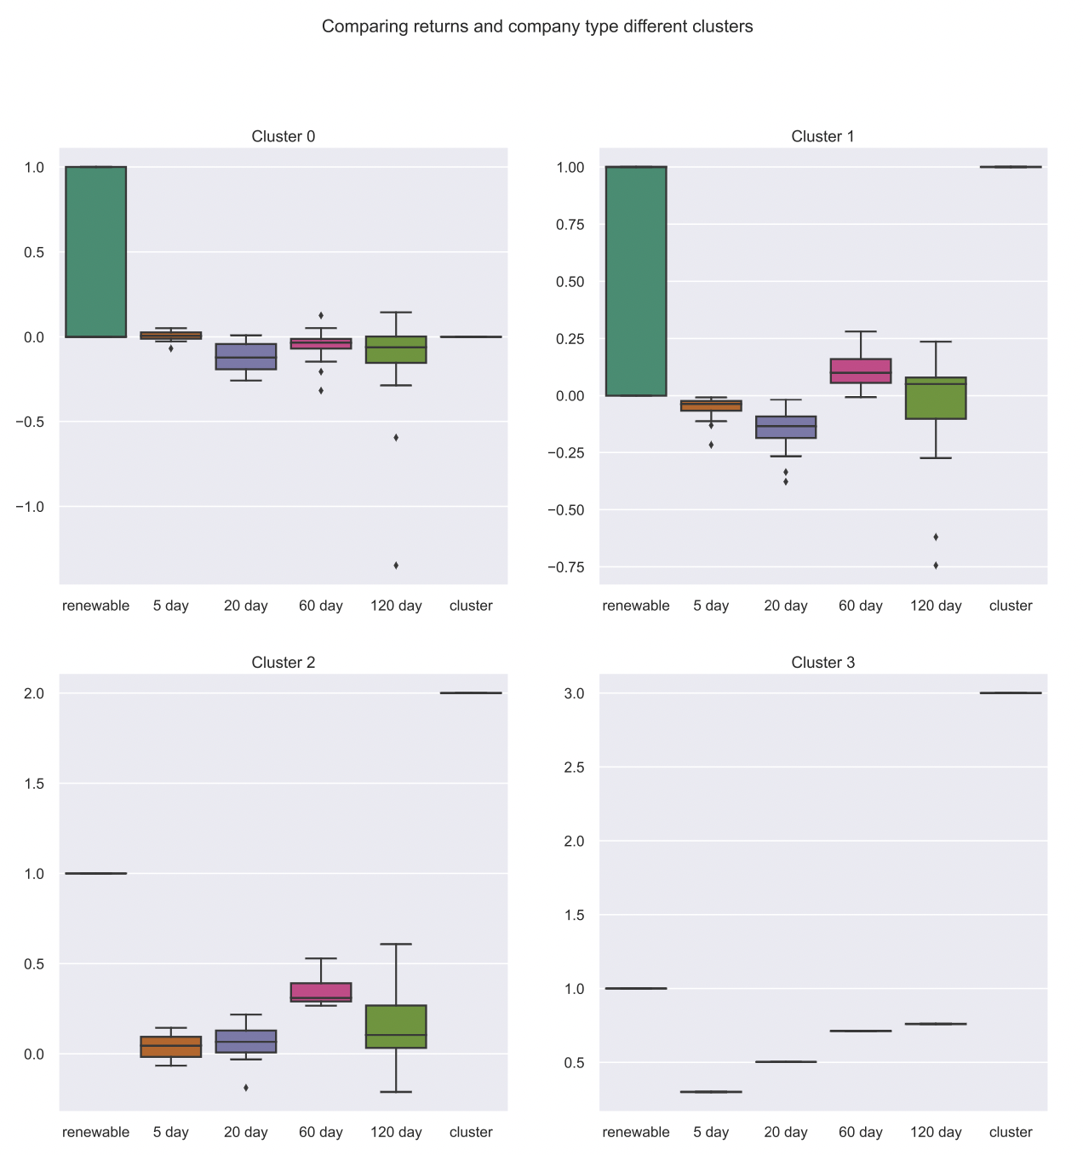
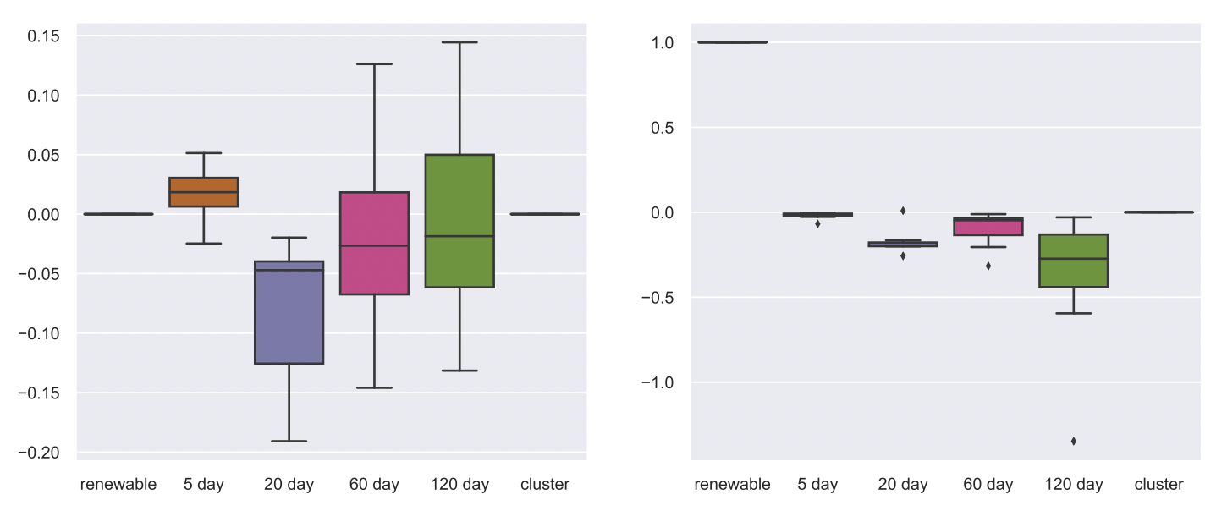
Clustering
19, 25, 8, and 1 observations in cluster 0-3.
Compare the short-term momentum with the long-term momentum.
Buy stocks in cluster 0---including FSLR, FREY, LIN, GM, ETN, ORA, AES, OXY, TTE, CVX, KMI, PXD, OVV, KBR, CIVI, KNTK, ROCC, NRG, USAC. Hold stocks in cluster 2 and 3—including TSLA, PLUG, JHX, MNTK, AMPS, AZRE, WAVE, ELLO, and VVPR. Sell the rest stocks.
the trend of renewable energy stocks will be better than that of fossil fuel stocks
Cluster 3: VVPR is an outlier.

Slide 13
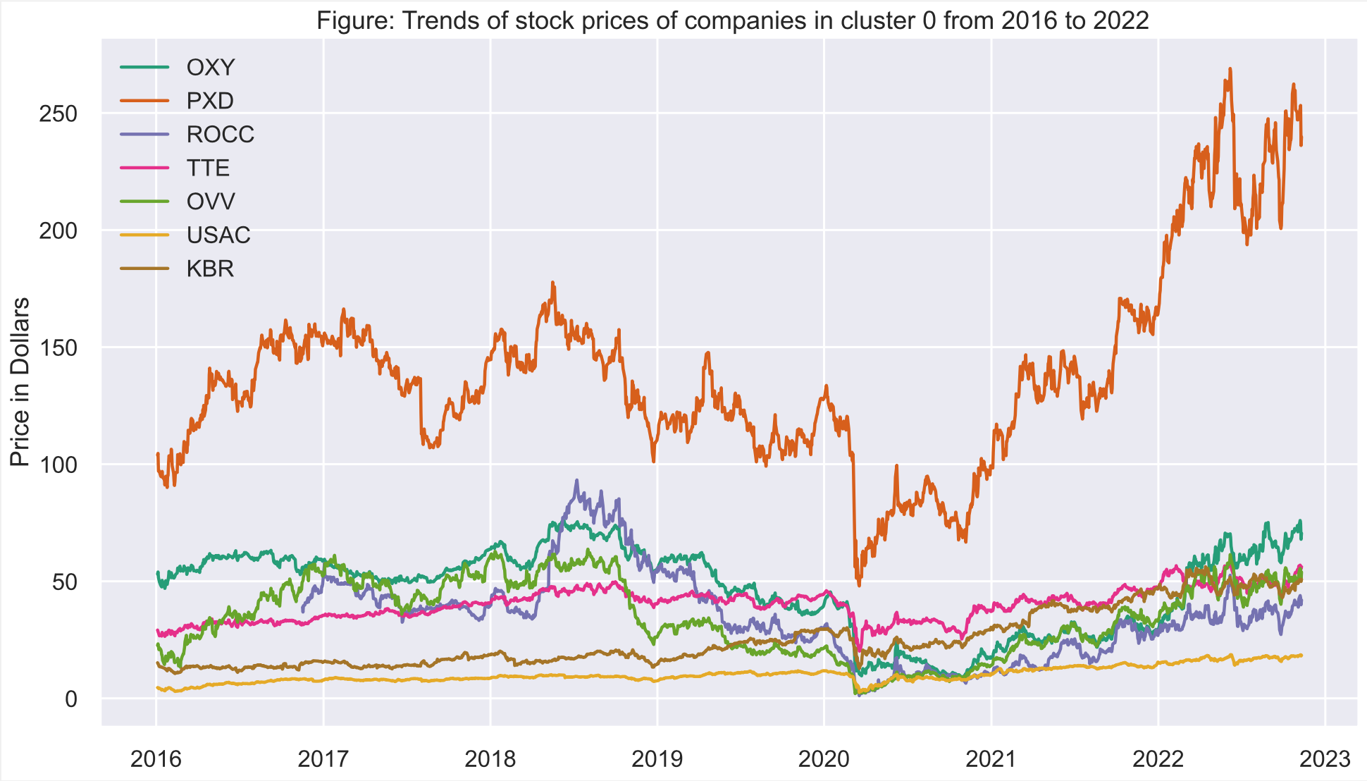
Association Analysis–Cluster 0
Notes:
OXY PXD ROCC TTE OVV form the association rule, they form strong positive relationships. where PXD has a significant value in price over others.
USAC and KBR are associated with each other. Based on the plot, USAC and KBR form a strong positive relationship, with KBR having a higher price value.

Slide 14
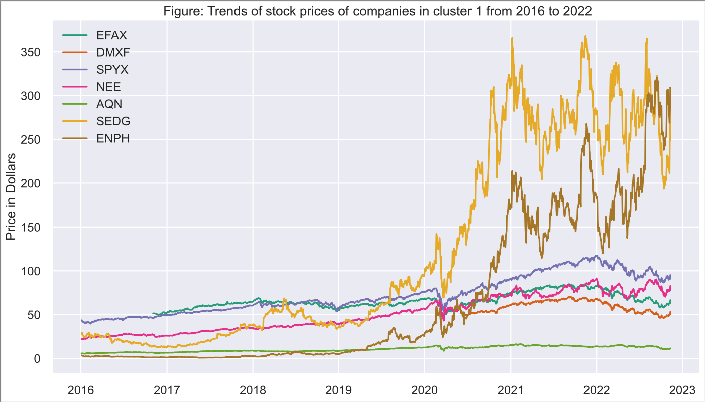
Association Analysis–Cluster 1
Notes:
EFAX, DMXF, SPYX, NEE, and AQN are associated. In the plot, we observed a strong positive relationship between them, with SPYX having the highest value and AQN having the lowest value.
SEDG and ENPHare associated with each other. In the plot, we observed a strong positive relationship between the two.

Slide 15
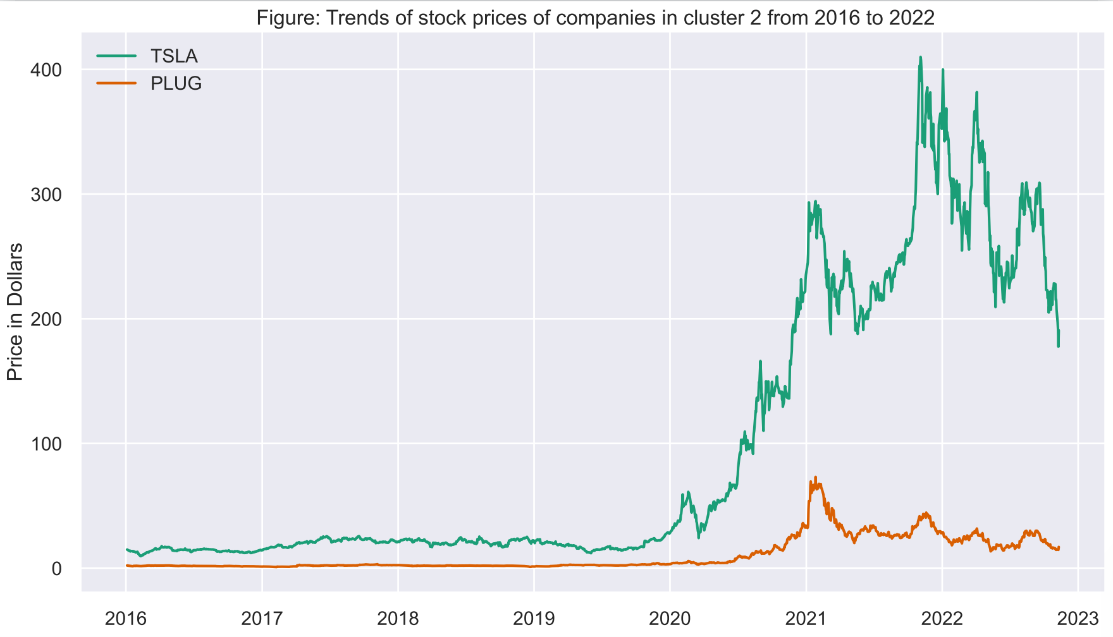
Association Analysis–Cluster 2
Notes:
TSLA and PLUG. are associated with each other. In the plot, we observed a strong positive relationship between the two, with TSLA having a significantly higher value in price.

Slide 16
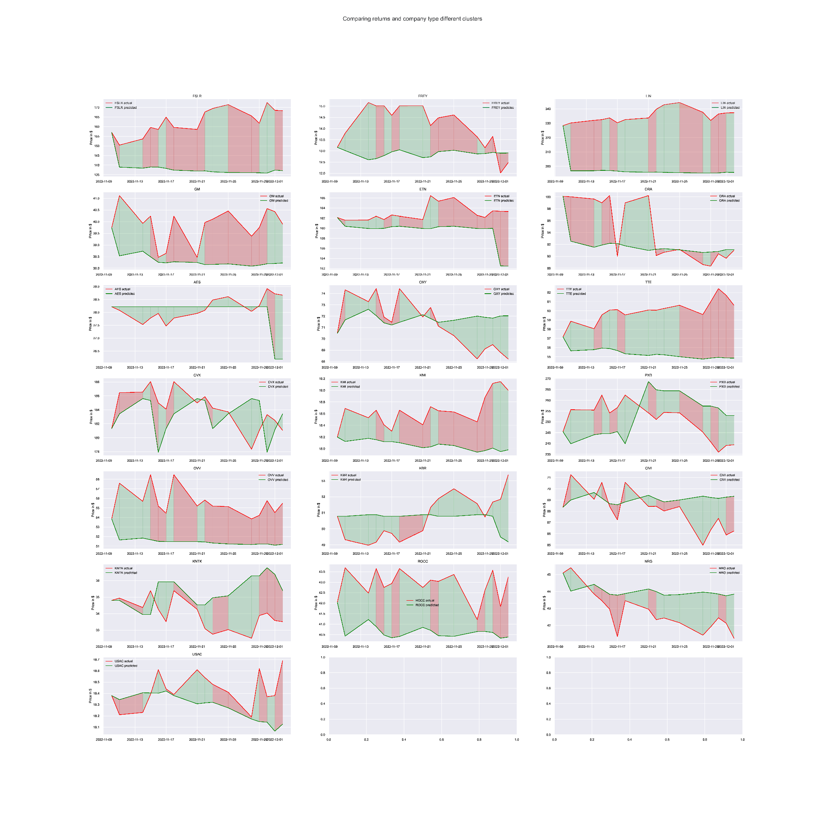
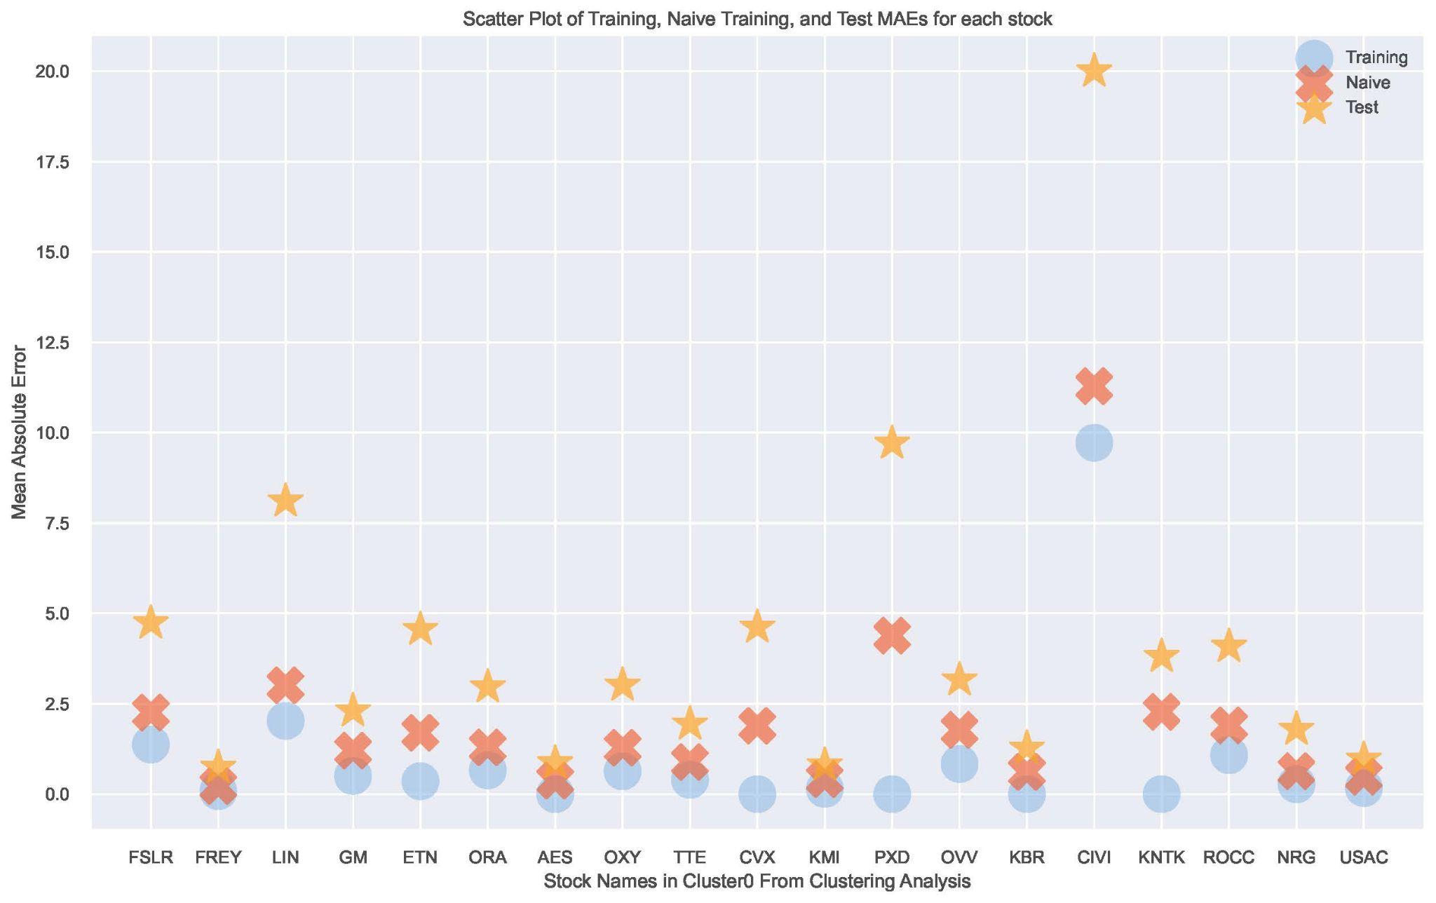
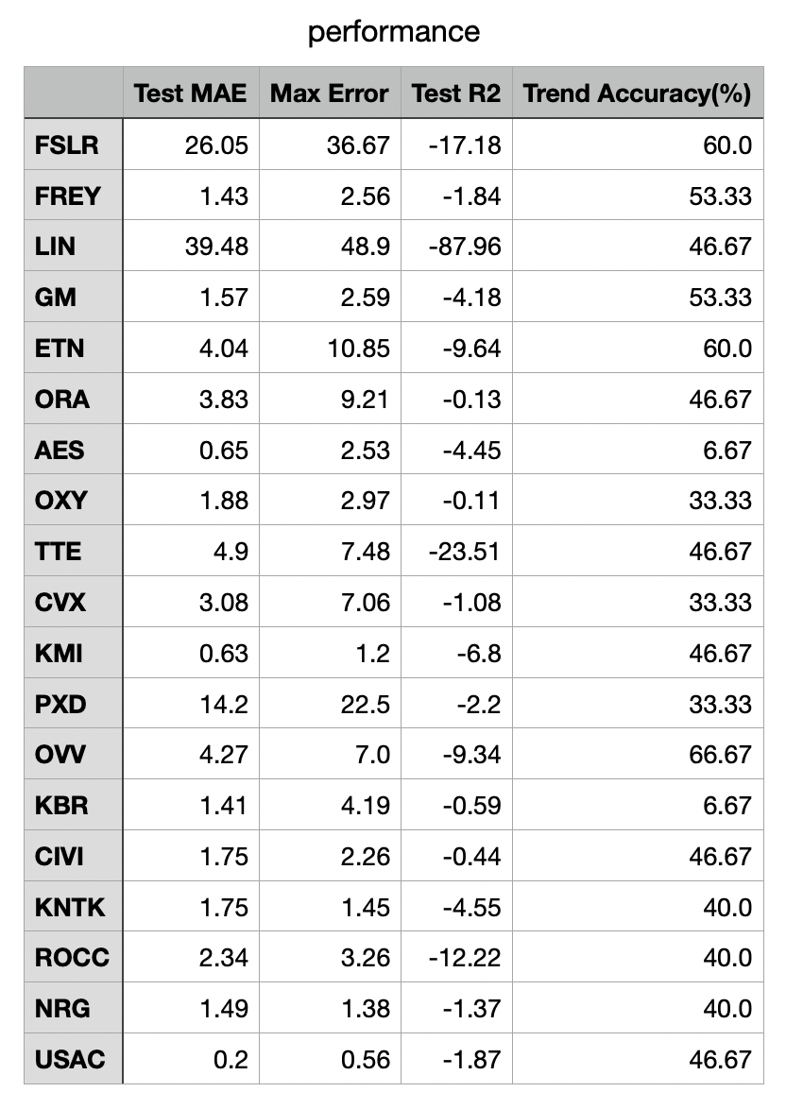
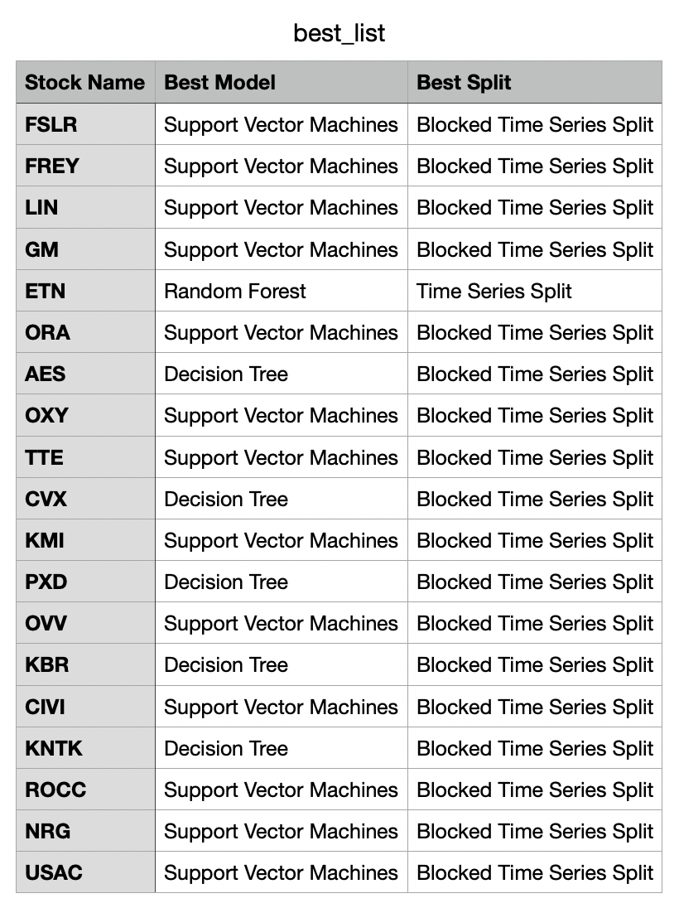
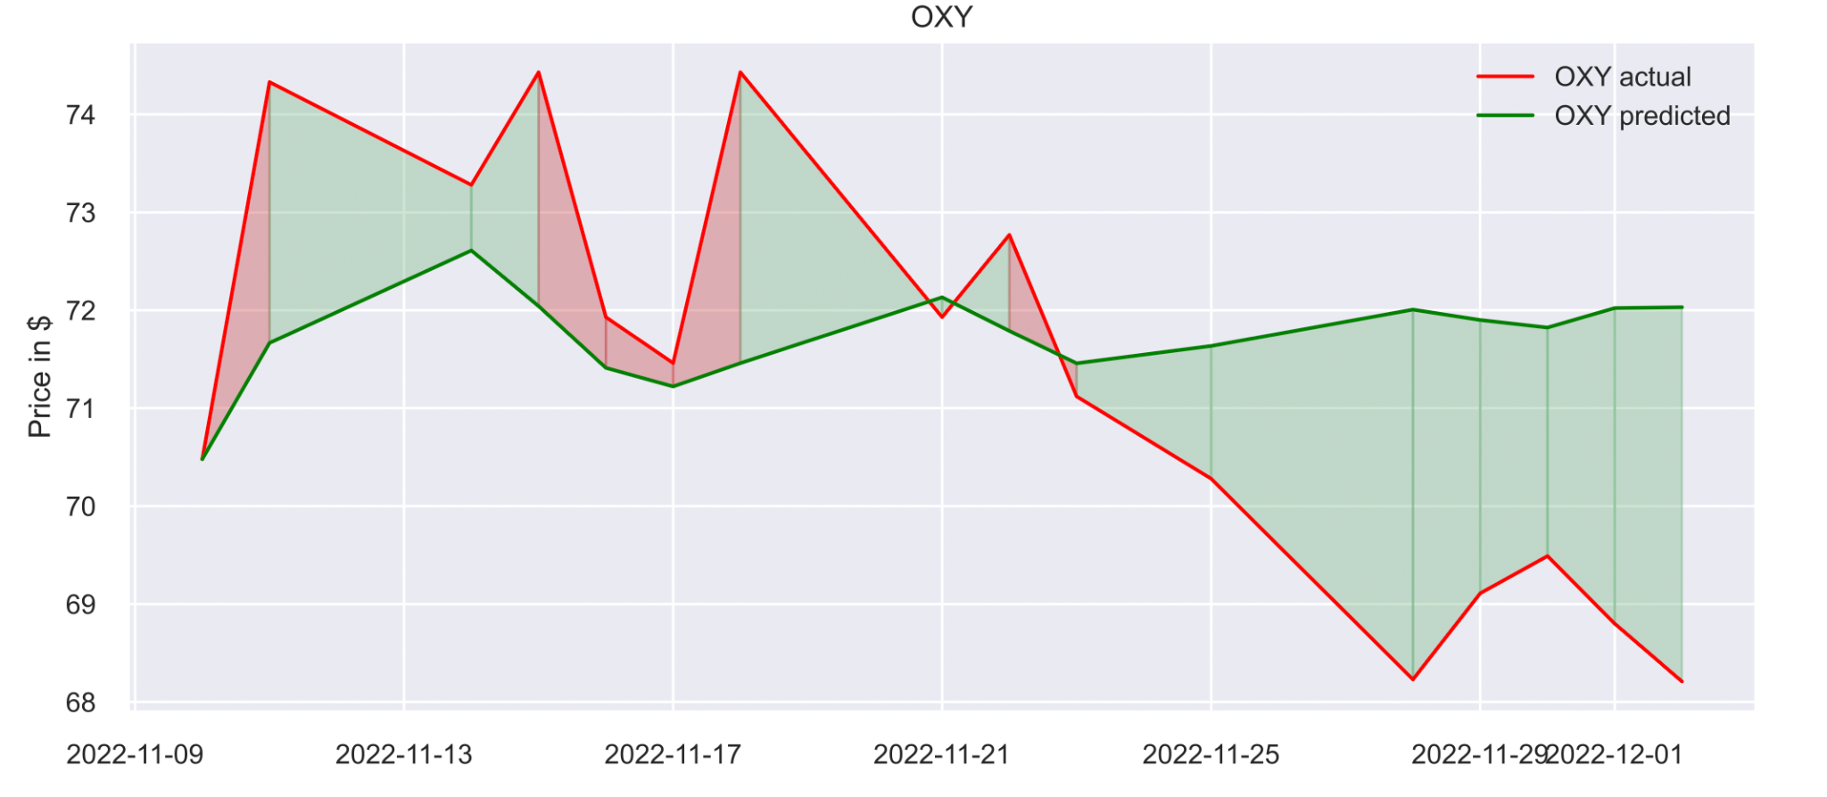
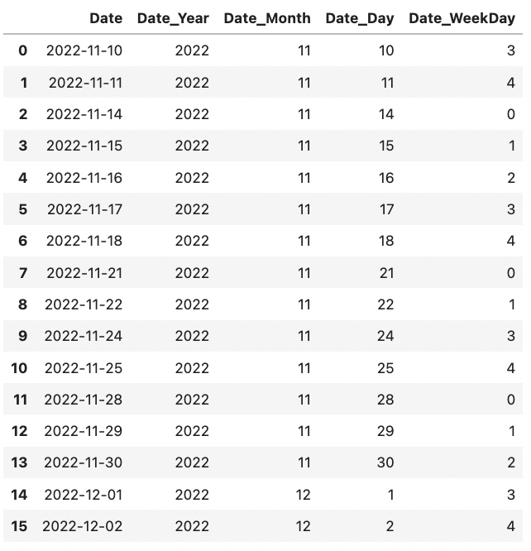
Estimation Task–Cluster 0
Why we start from cluster0…
Data Preparation
Only ‘Date’
‘Date’ feature engineering
Cross Validation choose Best -> Test MAEs
Statistical Approach & DM Approach
Overfitting, Underfitting
Real Prediction With Independent Test Data

Slide 17
Conclusions

Slide 18
Summary
Buy, hold, or sell stocks in our pool based on our suggestions.
Focus more on renewable energy stocks to seek more stocks with good potential in the future.
We should avoid adding the companies mentioned in the association rules in one portfolio as they share high similarities and increase risk.

Slide 19
Future Paths
Descriptive Task: diversification–include more factors to get the optimal weights
Predictive Task: deep learning approach + predict longer term with valuable features (sentiment, news, financial statements)

